Slide 1
Regression Analysis
Linh Le
Department of Information Technology

Slide 2
The Machine Learning Tree
Machine Learning
Supervised Learning
Unsupervised Learning
…
Has no targets
Classification
Regression
Target is class
Target is numeric

Slide 3
A Regression Example
Predicting students’ first year GPA from their high school GPA
First Year GPA | High School GPA
3.83 | 3.06
4 | 4.15
3.7 | 3.41
3.51 | 3.21
3.83 | 3.48
3.25 | 2.95
3.79 | 3.6
3.6 | 2.87
3.36 | 3.67
Input Data
Target Data
Is numeric
Numeric comparisons like < or > are meaningful
Math functions like average/mean, variance make are meaningful

Slide 4
A Simple Regression Can Be Visualized with Scatter Plot
Target value is usually the x-axis
Each dot is one instance in the data
Input data is usually the x-axis

Slide 5
Prediction Values
Is the expected values of the target when the input has certain values
Can be visualized in a scatter plot
Unlike in classification where predicted values are in a fixed set, predicted values in regression are continuous

Slide 6
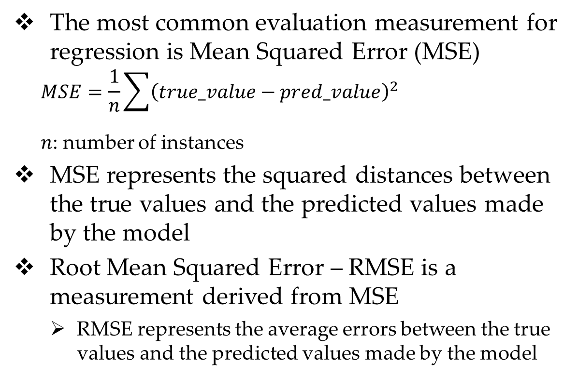
Mean Squared Error
The most common evaluation measurement for regression is Mean Squared Error (MSE)
$$MSE=\frac{1}{n}\sum{{\left(true_value−pred_value\right)}^{2}}$$
$n$: number of instances
MSE represents the squared distances between the true values and the predicted values made by the model
Root Mean Squared Error – RMSE is a measurement derived from MSE
RMSE represents the average errors between the true values and the predicted values made by the model
True GPA | Predicted GPA
2.58 | 2.893851
3.16 | 3.216037
2.51 | 3.027829
2.1 | 2.904163
3.41 | 3.177197
2.84 | 3.405919
2.95 | 3.041828
2.4 | 2.428391

Slide 7
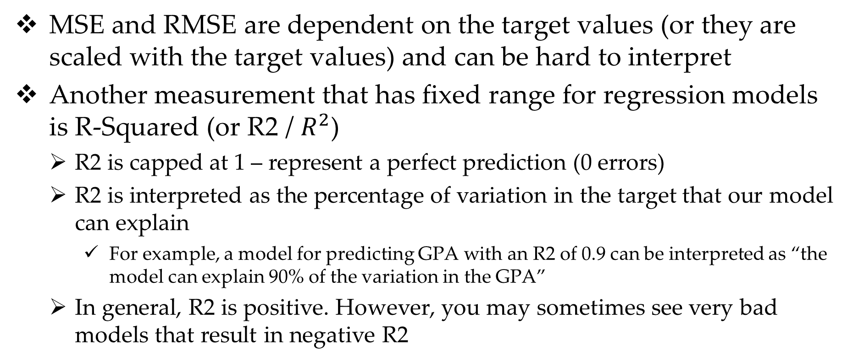
R-Squared
MSE and RMSE are dependent on the target values (or they are scaled with the target values) and can be hard to interpret
Another measurement that has fixed range for regression models is R-Squared (or R2 / $R^{2}$)
R2 is capped at 1 – represent a perfect prediction (0 errors)
R2 is interpreted as the percentage of variation in the target that our model can explain
For example, a model for predicting GPA with an R2 of 0.9 can be interpreted as “the model can explain 90% of the variation in the GPA”
In general, R2 is positive. However, you may sometimes see very bad models that result in negative R2

Slide 8
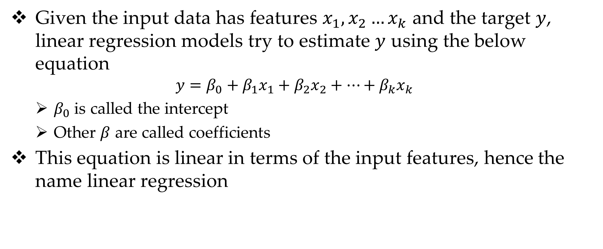
Linear Regression Model
Given the input data has features $x_{1},x_{2}…x_{k}$ and the target $y$, linear regression models try to estimate $y$ using the below equation
$$y=β_{0}+β_{1}x_{1}+β_{2}x_{2}+…+β_{k}x_{k}$$
$β_{0}$ is called the intercept
Other $β$ are called coefficients
This equation is linear in terms of the input features, hence the name linear regression

Slide 9
Adding Features to Linear Regression Models
Because the equation of linear regression is… linear, it does not handle non-linear relationship well
You can check if the relationship between features and target is linear or not with scatter plot

Slide 10
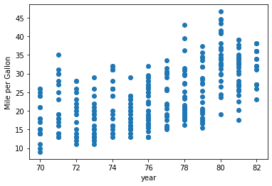
Linear Relationship Scatter Plot
The pattern seems like a straight line (and pointing up or down – a flat line indicates no relationship at all)

Slide 11
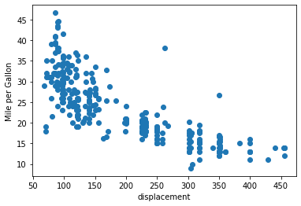
Non-Linear Relationship in Scatter Plot
The patterns look like a curve
Such patterns will be benefited from log and/or squared transformation
This is usually for linear regression only. Models like Random Forest are already good at handle non-linearity, so won’t be benefited much from this transformation

Slide 12
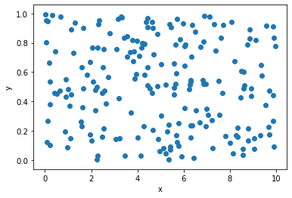
Scatter Plot of No-Relationship
You will see no patterns, the data points are spread-out and seem random
Including these kind of features in input data might actually hurt the models’ performance

